Slide 1


and
Multiplying
Dividing Integers
I positively
have negative
feelings about
this!
Made Easy!
PowerPoint!
Let the confusion End!
© Mike’s Math Mall

Slide 2

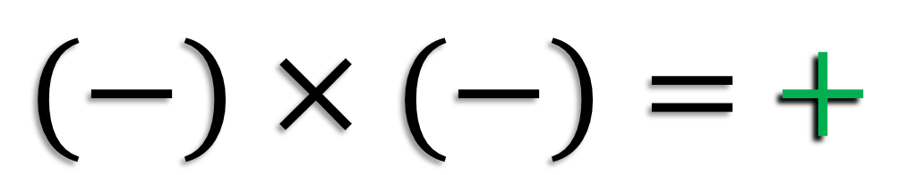
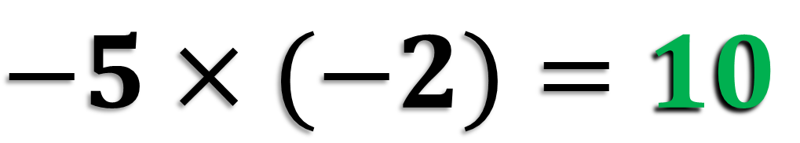
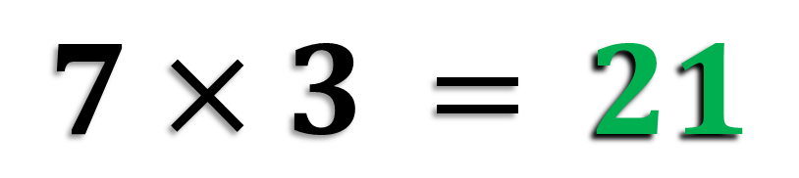

Multiplying Integers
Whenever we multiply two integers with “like” signs, the answer is always positive.
$(+)×(+)=$ $+$
$7×3$ $=$ $21$
$(−)×(−)=$ $+$
$$−5×(−2)=10$$

Slide 3
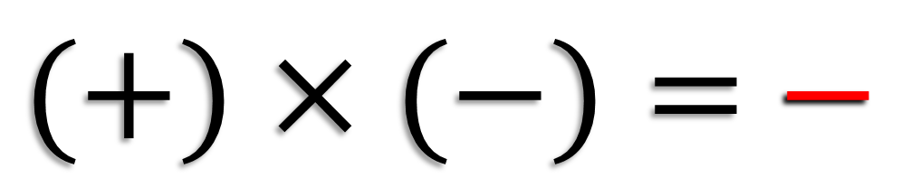
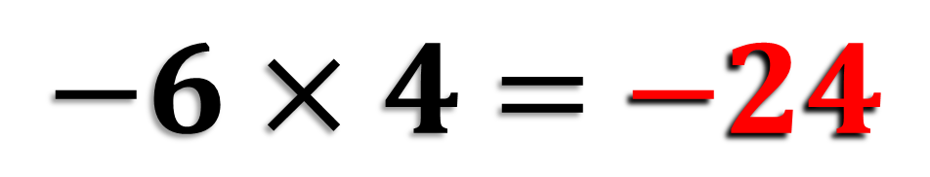
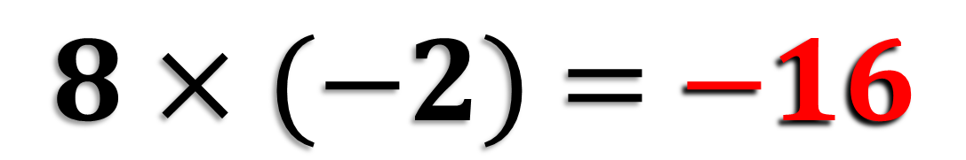
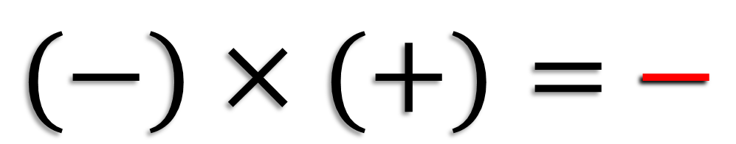
Multiplying Integers
Whenever we multiply two integers with “unlike” signs, the answer is always negative.
$(+)×(−)=$ $−$
$8×(−2)$ $=$ $−16$
$(−)×(+)=$ $−$
$−6×4$ $=$ $−24$

Slide 4


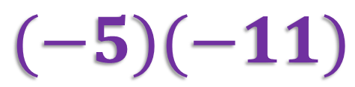

Something to keep in Mind
Here are some other ways that multiplying integers might appear:
Multiplying with a raised dot or using parenthesis:
$$−2 6$$
$$8(−3)$$
$$(−5)(−11)$$

Slide 5
Multiplying Integers
An expression with an even number of negative integers will always produce a positive answer.
An expression with an odd number of negative integers will always produce a negative answer.
Let’s take a look at a few examples!

Slide 6
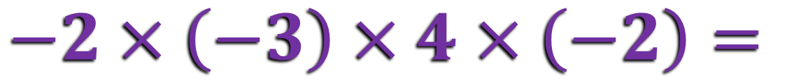

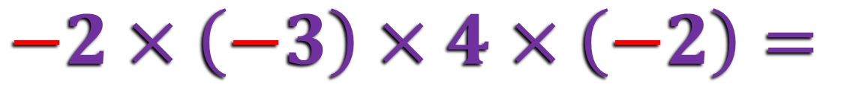
Multiplying Integers
Example 1:
$$−2×\left(−3\right)×4×\left(−2\right)=$$
$$−48$$
$$−2×\left(−3\right)×4×\left(−2\right)=$$
Since there are 3 negative integers (an odd amount), the answer will be negative.
Then, multiply from left to right to find the product.

Slide 7






It’s Time to Show Your Stuff!
Multiply the following integers.
$$=−30$$
$$=−90$$
$$=35$$

Slide 8

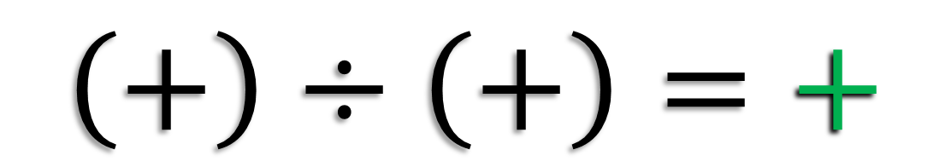
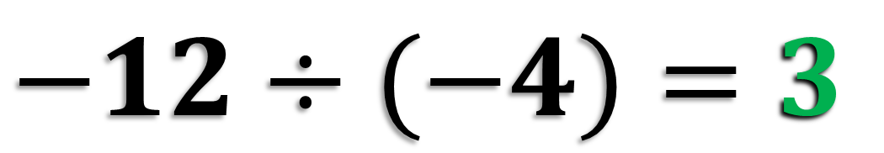

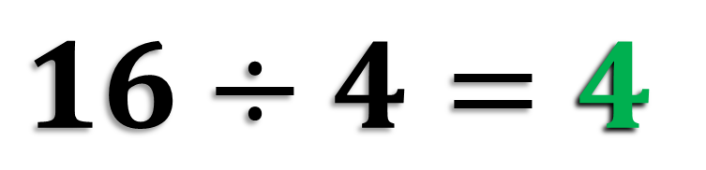
Dividing Integers
Whenever we divide two integers with “like” signs, the answer is always positive.
$$\left(+\right)÷\left(+\right)=+$$
$$16÷4=4$$
$$(−)÷(−)=+$$
$$−12÷(−4)=3$$

Slide 9


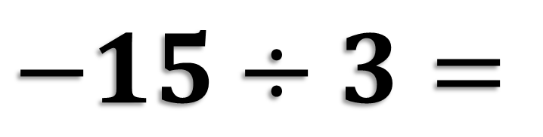

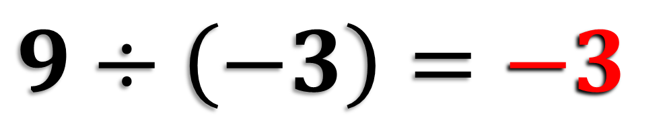
Dividing Integers
Whenever we divide two integers with “unlike” signs, the answer is always negative.
$$(+)÷(−)=−$$
$$9÷\left(−3\right)=−3$$
$$(−)÷(+)=−$$
$$−15÷3=$$
$$−5$$
What did you notice about the rules for multiplying and dividing integers?
If you said they’re exactly the same, you’re right!

Slide 10

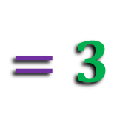




It’s Time to Show Your Stuff!
Multiply or divide the following integers.
$$=−6$$
$$=−8$$

Slide 11
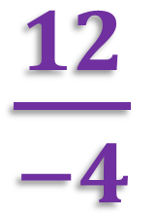
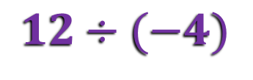
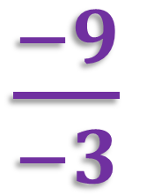
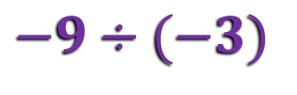
Something to keep in Mind
Here are some other ways that dividing integers might appear:
Dividing with a fraction bar:
$\frac{−9}{−3}$
→
→
$$−9÷(−3)$$

Slide 12
Dividing Integers
An expression with an even number of negative integers will always produce a positive answer.
An expression with an odd number of negative integers will always produce a negative answer.
Let’s take a look at a few examples!

Slide 13

Multiplying and Dividing Integers
Example 3:
$$25÷(−5)×4÷\left(−4\right)×(−2)×(−7)$$
$$=70$$
4 negative integers produce a
positive answer.
Multiply and divide from left to right to simplify.

Slide 14
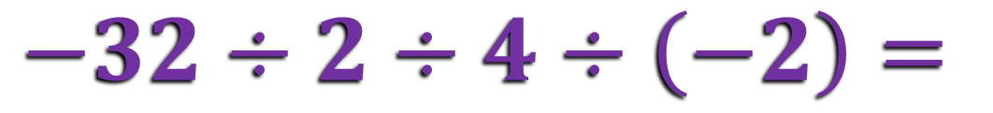
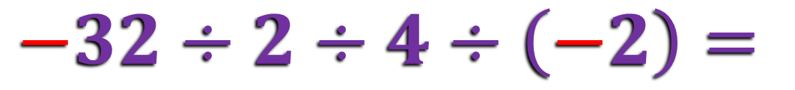

More than 2 Integers
Example 2:
$$−32÷2÷4÷\left(−2\right)=$$
$$2$$
$$−32÷2÷4÷\left(−2\right)=$$
2 negative integers (an even amount) result in a positive quotient.
Divide from left to right to simplify.

Slide 15


Multiplying and Dividing Integers
So I just
count negative
signs to determine the sign of my answer?
Then I
just multiply or
divide from left to right?
Not as
cool as my
new hat!
That’s it! An even number of negative signs equals a positive answer, and an odd number equals a negative answer.
Pretty cool, huh?
Good point, Captain America!

Slide 16

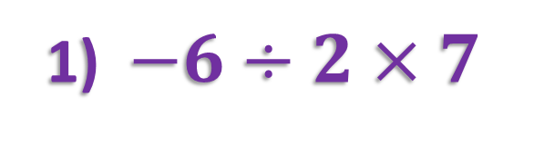
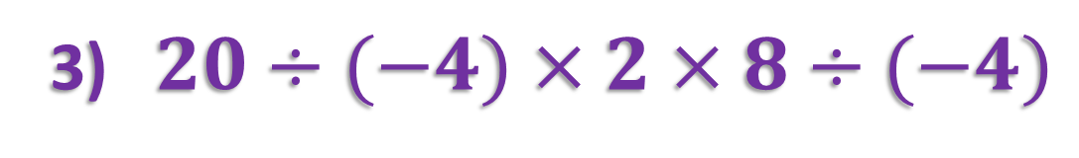

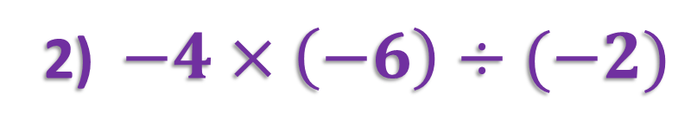

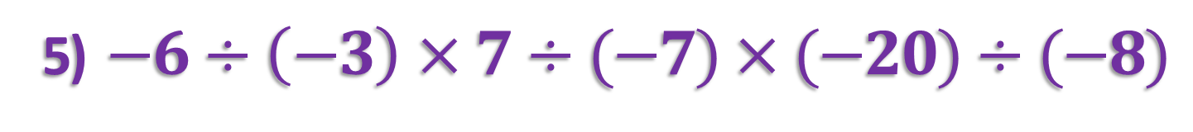

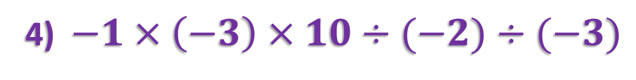

Let’s See if you have This!
Multiply and/or divide.
1) $−6÷2×7$
2) $−4×\left(−6\right)÷(−2)$
$$=−21$$
$$=−12$$
3) $20÷(−4)×2×8÷(−4)$
$$=20$$
4) $−1×\left(−3\right)×10÷(−2)÷(−3)$
$$=5$$
5) $−6÷\left(−3\right)×7÷(−7)×(−20)÷(−8)$
$$=−5$$

Slide 17

Multiplying and Dividing Integers
So how do you feel after the practice problems, Sparky?
#1 Fried Chocolate Banana Eater
I might
have to consider myself a multiplying and dividing integers’ ace, sir!
Congratulate me
after I destroy a couple
dozen fried chocolate bananas!
Oh yeah!
That’s awesome! Congratulations!
Well then go get em, Sir Grub-a-Lot!

